Slide 1







Data Analyst Project | 2025
WORLD LAYOFFS ANALYSIS
By Muhammad Fakhri Azhar
An Exploratory Data Analysis Project using MySQL

Slide 2

INTRODUCTION
The COVID-19 pandemic, which emerged in early 2020, has had far-reaching effects on global economies, leading to significant disruptions and workforce reductions. As companies sought to navigate the unprecedented challenges posed by the pandemic, many implemented mass layoffs as a necessary cost-cutting strategy. This analysis aims to explore layoff trends globally from 2020 to 2023, pinpointing the sectors and countries that were most impacted and identifying companies that experienced the highest levels of layoffs.

Slide 3

DATA OVERVIEW
This dataset contains information about company layoffs worldwide from the start of the COVID-19 pandemic, March 2020, to March 2023. It records various companies from different industries and countries that conducted layoffs during this period.
This dataset is useful for understanding global layoff trends during the crisis, including the most affected industries, critical layoff periods, and potential correlations with a company's financial status.
Dataset Link :
https://github.com/mfakhriazhar/data-cleaning-sql/blob/main/layoffs_data.csv

Slide 4


OBJECTIVES AND METHODOLOGY
This analysis aims to explore layoff trends worldwide from March 2020 to March 2023 using structured data exploration through SQL. The main objectives are to identify trends in layoffs over time, determine which industries and countries are most affected, and highlight companies with the largest number of layoffs. The methodology involves querying and aggregating data using SQL to uncover patterns and generate insights, focusing on key variables such as total layoffs, industry, company, country, and funding stage. The approach is purely exploratory, with the goal of presenting data.

Slide 5
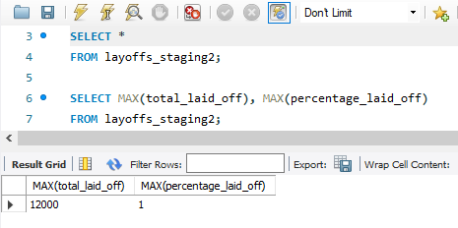
KEY INSIGHTS
QUERY
INSIGHTS
By calculating the maximum values for total_laid_off and percentage_laid_off, we found that the highest number of layoffs reached 12.000 people, with some companies reporting layoffs that amounted to 100% of their workforce. This indicates extreme measures taken by certain companies to address the financial strains caused by the pandemic, reflecting the severity of the economic impact across various sectors.

Slide 6
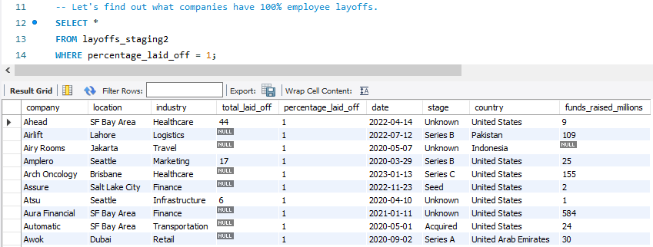
KEY INSIGHTS
QUERY
INSIGHTS
Based on the results of the above query, it can be seen that a large number of companies have carried out layoffs with the rate reaching 100%. 116 companies have implemented these drastic measures, highlighting the severe impact of economic pressures and changing market conditions on the workforce. This alarming trend may raise concerns about job security and the overall stability of various industries.

Slide 7
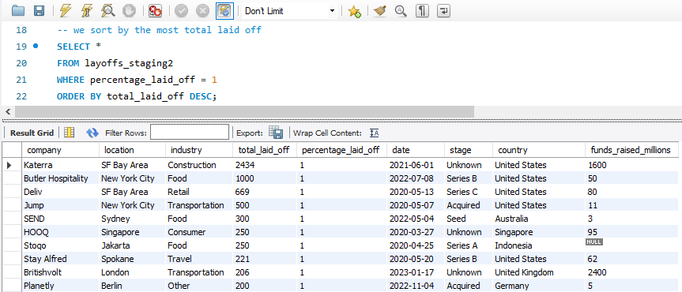
KEY INSIGHTS
QUERY
INSIGHTS
And if we sort the companies with percetentage_laid_off reaching 100% based on the total_laid_off they have. The company with the highest number of layoffs is Katerra in the US with a total of 2434 people. Katerra is an American construction technology company founded in 2015 by Michael Marks (former CEO of Flextronics and interim CEO of Tesla) and Fritz Wolff. The impact of the COVID-19 pandemic and the failure to raise additional capital worsened the company's financial situation. In June 2021, Katerra filed for Chapter 11 bankruptcy protection and announced the closure of most of its operations in the US.

Slide 8
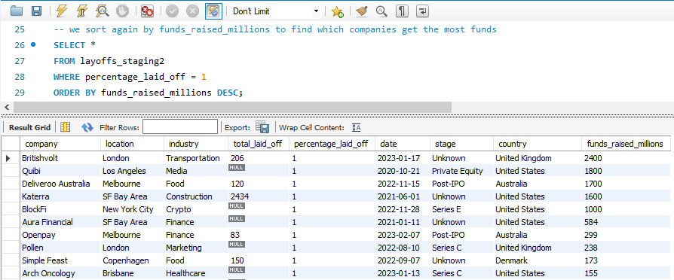
KEY INSIGHTS
QUERY
INSIGHTS
And we if sort again by funds_raised_millions to find which companies get the most funds. We found out the company that gets the most funds is Britishvolt (UK). Despite raising an impressive $2.4 billion in funding, Britishvolt still ended up laying off all of its employees. This highlights a critical insight that even companies with massive financial backing are not immune to collapse, especially when faced with poor financial management, unstable market conditions, or operational challenges

Slide 9
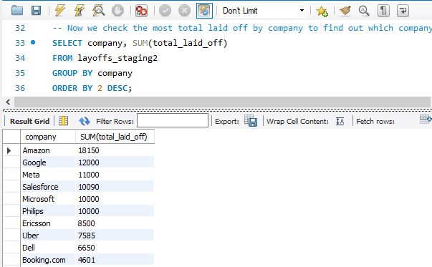
KEY INSIGHTS
QUERY
INSIGHTS
During the COVID-19 pandemic, tech giants such as Amazon, Google, and Meta saw a surge in demand for digital services, e-commerce, and online communication. This boom led to aggressive expansion and mass hiring across the industry. However, as the world shifted toward post-pandemic recovery, market demands normalized, operating costs rose, and investors started pushing for efficiency. As a result, these companies began executing large-scale layoffs: Amazon cut over 18.000 employees, Meta laid off more than 11.000, and Google reduced its workforce by 12.000 in early 2023. This trend is strongly reflected in the data, where tech companies dominate the top of the layoff charts, in terms of total_laid_off.

Slide 10
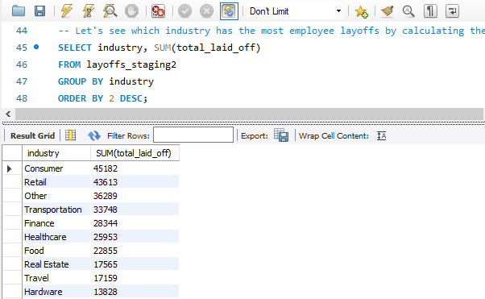
KEY INSIGHTS
QUERY
INSIGHTS
Aside from the tech industry, some of the industries most affected by the pandemic include the consumer and retail sectors, which recorded the highest number of employee layoffs. This is understandable, as many physical stores were forced to shut down due to widespread lockdowns and restrictions around the world. In addition, the pandemic had a significant impact on other sectors such as transportation, finance, healthcare, and more.

Slide 11
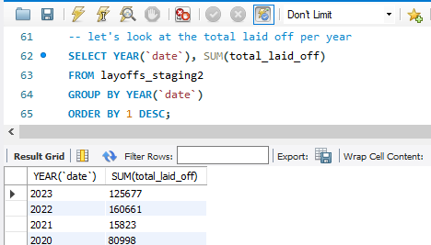
KEY INSIGHTS
QUERY
INSIGHTS
The annual layoff trend from 2020 to 2023 shows significant fluctuations. In 2020, there were around 80.998 layoffs, marking the initial impact of the COVID-19 pandemic on the global workforce. Interestingly, the number dropped sharply in 2021 to 15.823, which may indicate a temporary recovery or stabilization. However, in 2022, layoffs surged drastically to 160.661, becoming the highest annual total in the dataset likely driven by economic uncertainty, overhiring during the pandemic, and rising operational costs. By 2023, the number of layoffs dropped again to 125.677, suggesting that companies may have begun to stabilize or adapt to the new post-pandemic environment. This trend highlights how the global labor market reacted dynamically to the waves of crisis and adjustment over the three-year period.

Slide 12
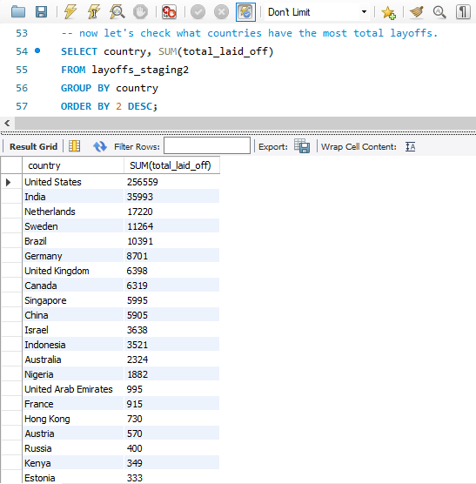
KEY INSIGHTS
QUERY
INSIGHTS
The country-wise layoff data shows that the United States leads by a wide margin, recording over 256.559 layoffs, making up the majority of the global total. This reflects the large concentration of major tech companies headquartered in the US, many of which implemented significant workforce reductions during and after the pandemic. India follows in second place with approximately 35.993 layoffs, likely driven by its fast-growing tech and startup sector. The Netherlands, Sweden, and Brazil round out the top five, each experiencing layoffs in the range of 10.000 to 17.000 employees. Notably, Indonesia ranks 12th with 3.521 layoffs, indicating that while the country was affected, the scale was relatively smaller compared to Western nations.

Slide 13
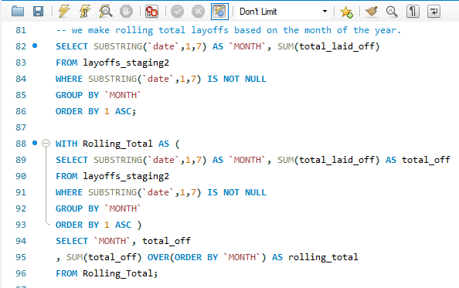
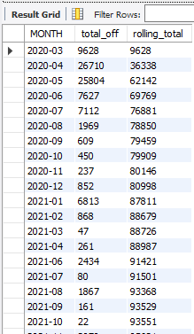
KEY INSIGHTS
QUERY
INSIGHTS
The rolling total of layoffs from March 2020 to March 2023 reveals a clear accumulation of job losses over time. It started with 9.628 layoffs in March 2020, shortly after the onset of the COVID-19 pandemic. By the end of 2020, the number had surged to 80.998. In early 2021, the total rose slightly to 87.811, and by the end of 2021, it had reached 96.821. A small increase occurred in early 2022 to 97.331, but by the end of 2022, layoffs had jumped significantly to 257.482. The number continued climbing in early 2023, hitting 342.196, and by March 2023, the cumulative total stood at 383,.59 layoffs. This trend shows how the global workforce continued to feel the ripple effects of economic uncertainty long after the initial pandemic shock, with the most dramatic rise occurring throughout 2022.

Slide 14
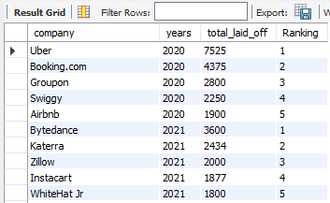
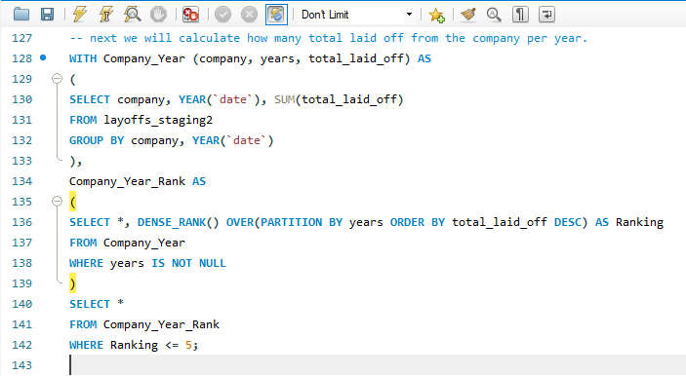
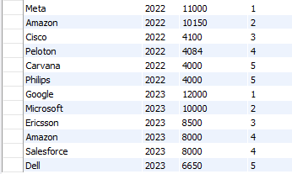
KEY INSIGHTS
QUERY

Slide 15
KEY INSIGHTS
INSIGHTS
The top 5 companies with the highest layoffs each year from 2020 to 2023 reveal some consistent and notable names. In 2020, Uber led the layoffs with 7,525 employees, followed by Booking.com, Groupon, and Airbnb all heavily impacted by travel restrictions. In 2021, companies like Katerra and Zimyo topped the list, reflecting failures or shutdowns of startups. By 2022, tech giants such as Meta, Amazon, and Cisco began appearing prominently, marking the start of large-scale tech restructuring. The trend continued in 2023, with Google, Microsoft, Salesforce, and Dell among the top 5 all reducing thousands of employees as part of post-pandemic corrections and operational efficiency moves. This shift from travel/startup sectors in early years to big tech in later years illustrates how the impact of global disruptions evolved over time.

Slide 16
CONLUSION
The analysis of global layoffs from 2020 to 2023 reveals the widespread and long-lasting impact of the COVID-19 pandemic on the global workforce. Layoffs reached a cumulative total of over 383,000 employees by March 2023, with a significant spike in 2022, indicating deep economic pressures across industries. Although tech companies initially expanded during the pandemic boom, many including Amazon, Meta, and Google later reversed course and executed large-scale layoffs due to rising costs, overhiring, and shifting market demands.
Notably, 116 companies laid off 100% of their workforce, with Katerra in the U.S. recording the highest total at 2,434 employees, and Britishvolt in the U.K. collapsing despite raising $2.4 billion in funding. This highlights that even well-funded companies are not immune to failure when faced with mismanagement or market instability.
The United States dominated in total layoffs, reflecting its high concentration of major tech firms. Meanwhile, industries like consumer, retail, transportation, and finance were also severely affected due to lockdowns and global restrictions. The transition of top layoff contributors from travel-related and startup companies in early years to tech giants in later years reflects how economic shocks evolved and shifted across sectors over time.
Overall, this analysis underscores the critical importance of sustainable workforce planning, adaptability, and strong financial management in navigating global crises.

Slide 17

CLOSING & CONTACT INFO
Let this data serve as a reminder — in an ever-changing world, sustainable growth and strategic workforce planning are not optional, but essential. Thank you for your attention. Let's continue using data to make smarter, more resilient decisions.
Github Code :
https://github.com/mfakhriazhar/world_layoffs_analysis/blob/main/Project%20Exploratory%20Data%20Analysis%20with%20MySQL.sql
Email : mfkriazh57@gmail.com
Phone : 0857-2454-9367
LinkedIn : Muhammad Fakhri Azhar
Portfolio : Click here
GitHub : mfakhriazhar

Slide 18

Data Analyst Project | 2025
THANK YOU
mfkriazh57@gmail.com

